Slide 1


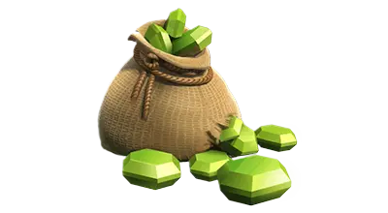
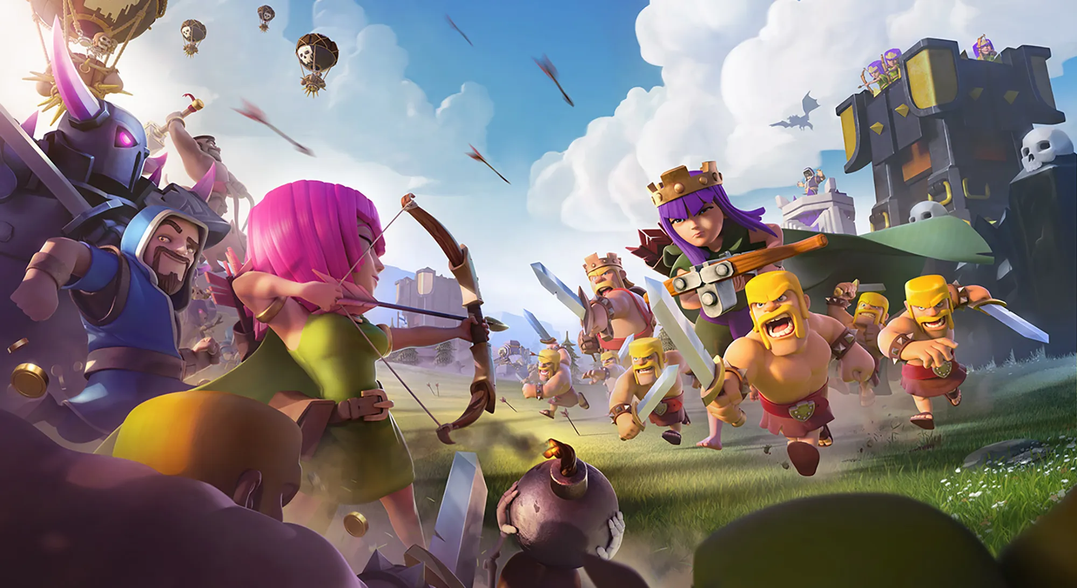
The Pinch: Economies, Exploitation, Item
: Gems
CCT382H5
Game Reading Presentation
Professor Michael Nixon
Presenters: Syed Hassan Pirzada & Joshua Wuebbolt

Slide 2


Introduction - The Pinch: Economy, Rarity, Items
The Pinch
Key concept that refers to the moment in gameplay a player feels slowed down or stuck
Intentional game strategy that pressures players to spend more time, effort, or money
Economies
In-game economies are built around these pinches, developers create limited quantity items so players feel scarcity of resources
Rarity
The rarity of an item has an impact because the rarer an item is the more power it has to overcome the pinch

Slide 3

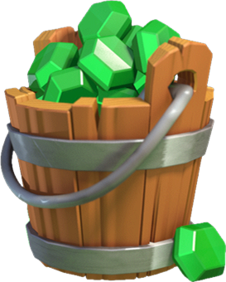
Introduction - Clash Of Clans: Gems
Clash of Clans
Popular global free to play mobile video game
Progression is made through collecting resources, upgrading buildings, waiting through long wait times
Game design embodies slow progression and scarcity of resources referring to the concept of The Pinch
Gems
Premium currency used to buy resources, instantly upgrade buildings, and skip through long wait times
Represents the most direct way to relieve a pinch whenever progress becomes slow
Shortcut to instantly progress forward
Very hard to obtain through normal play and strongly connected to real money purchases

Slide 4
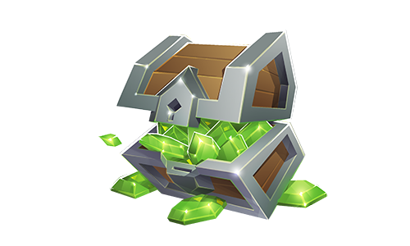

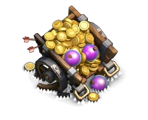
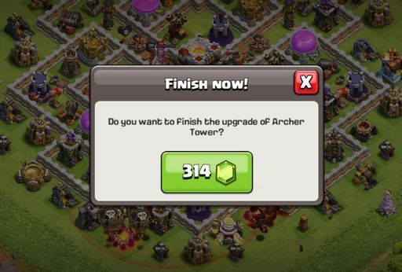
Application of Gems in Clash of Clans
Buying Resources
Skipping Wait Times
Buy Another Builder

Slide 5

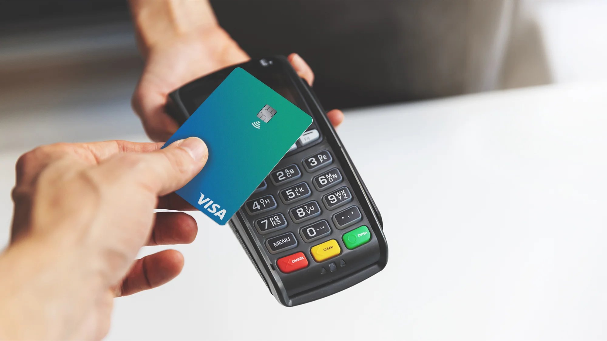
Connection to Readings - Evans
The economics of free: Freemium games, branding and the impatience economy
“In particular, the way the games rely on, and exploit, player impatience, points to an additional dimension to their economic structure. Real money in these games does not simply function in the exchange, or ownership, of virtual assets, but also to control the temporal dynamics of the gameplay experience.” (Evans, 2016, p. 24)
Freemium games create value by controlling time, referred to as temporal dynamics
Players are not paying for new game content but rather for convenience in gameplay
Developers delay game experience, and premium currency becomes a direct way to bypass that delay

Slide 6
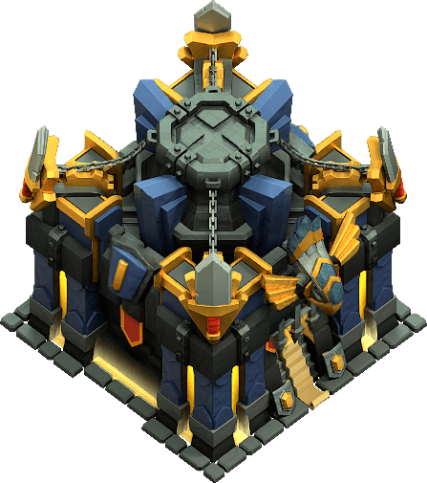
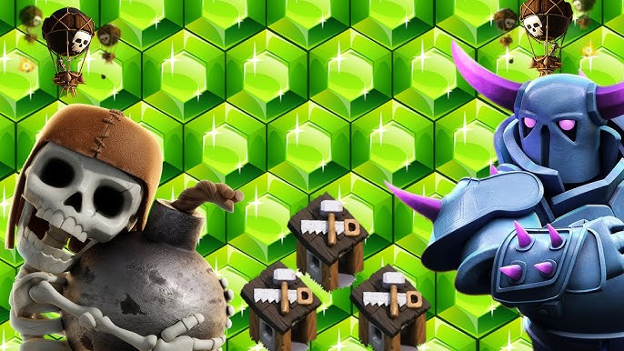
Connection to Readings - Evans
Connection to Gems from Clash of Clans
Perfectly fits Evans freemium model as upgrades can take up to hours, days, and even weeks - this is the temporal dynamic Evan refers to
Game is structured by making players wait
Although gems do not provide any new gameplay, they are able to bypass the waiting time
Ultimately relives the Pinch players might be facing

Slide 7
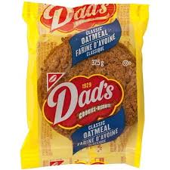
Question!
An example of “The Pinch” in a game
An example of a Freemium game you played and why you kept playing it

Slide 8
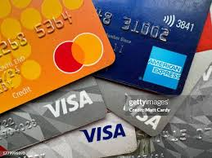
How SuperCel Tricks us into buying Gems

Slide 9
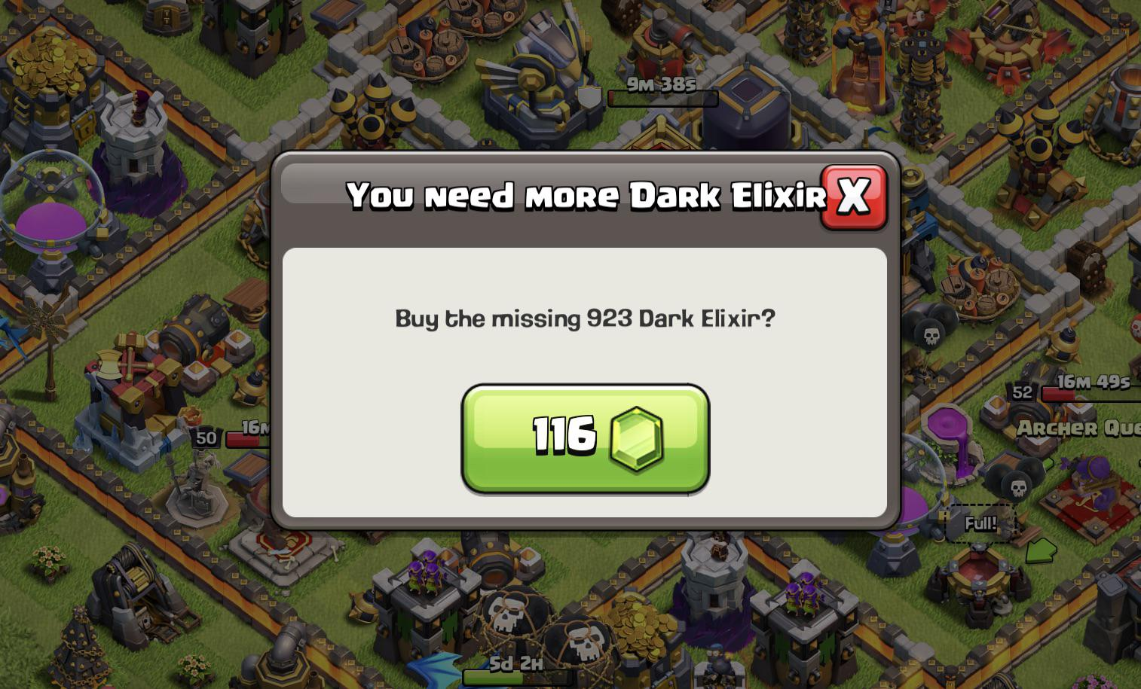
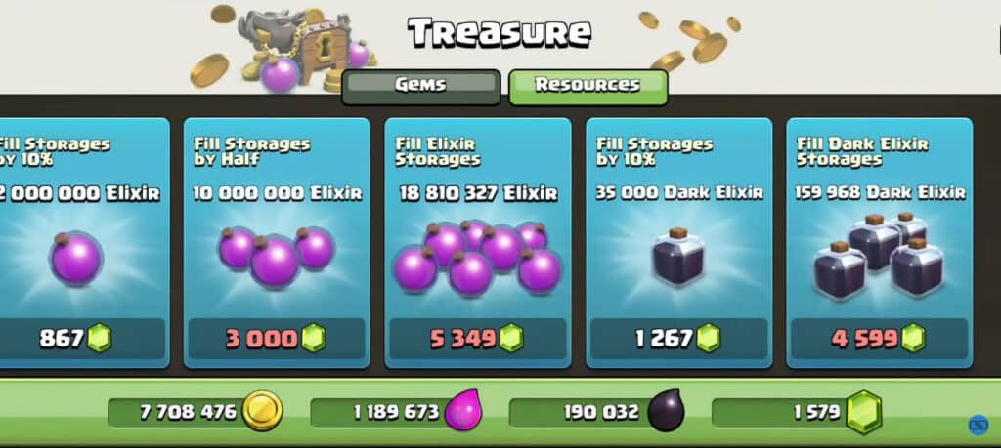
Money spent is obstructed by Gems
You cannot directly buy gold or elixir
Don’t conceptualize the true dollar value of your purchase
Exact cost is unclear
You didn’t spend $15, you spent 1200 gems
There is no set value for gems or resources so it's hard to say how much you spent.

Slide 10
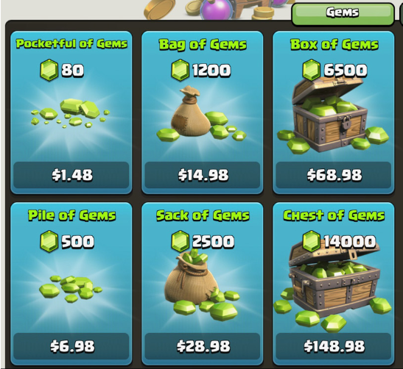
How the Player is Exploited into Buying more Gems
Gems are cheaper the more you buy
This incentivises the player to buy more
You feel like you’re getting ripped off if you don’t get the best value package.
Prices don’t end in whole numbers
Prices that end in .99, .98, .97 are used to trick our brains into thinking the prices are cheaper.

Slide 11
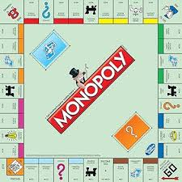
SuperCel Owns a Monopoly
You cannot get buy Gems from anywhere else
No marketplace
You cannot receive gems without SuperCel’s approval
They have full control of the economy
They get to set the prices as high as they want

Slide 12

How this Connects to the Pinch
When the player runs out of resources the solution is buying gems, BUT:
The true value of gems is hidden from you
Cost is obstructed
You cannot buy them anywhere else, there is nothing cheaper

Slide 13
Question!
Another game that obstructs the true value of its premium currency and how it does that
A non-gaming example of how stores trick us into buying more.

Slide 14
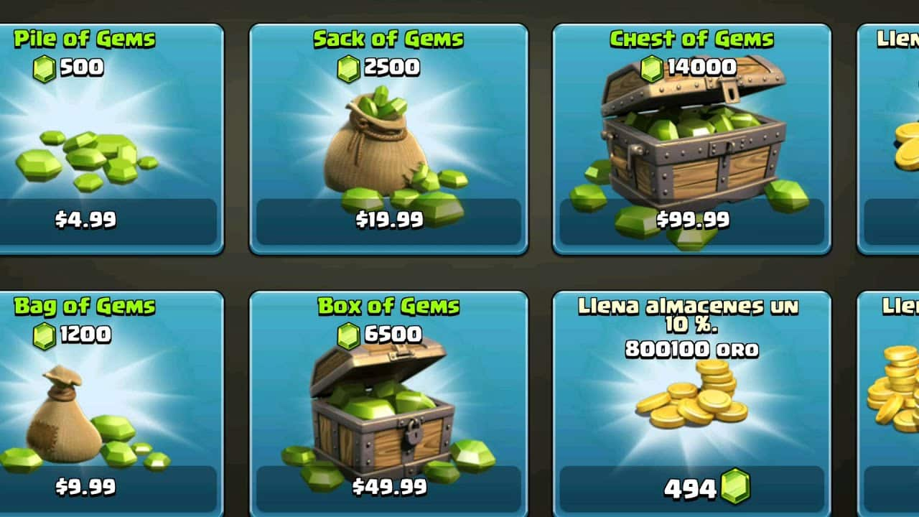
How are Premium Currencies made Desirable?

Slide 15
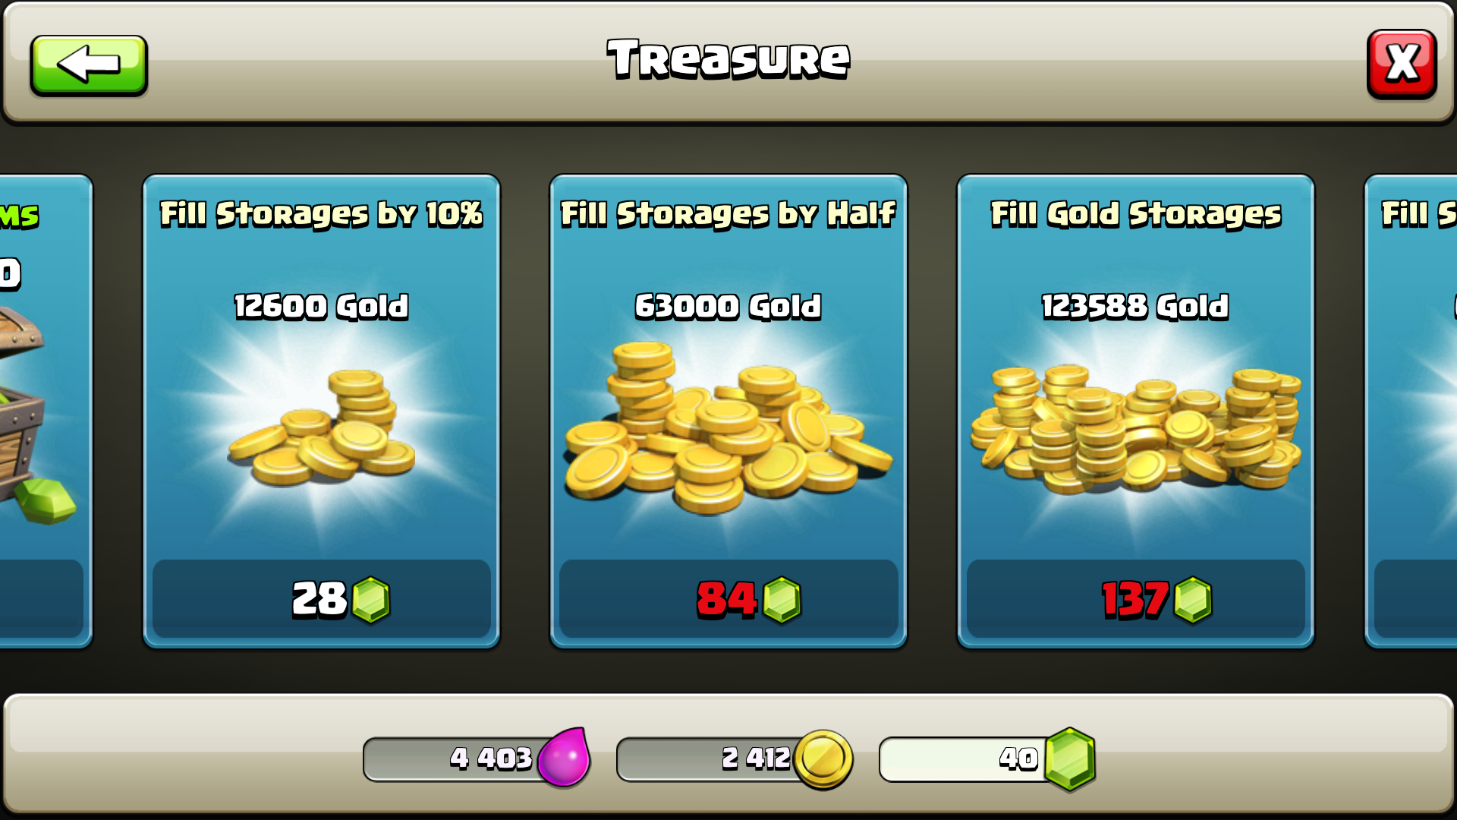
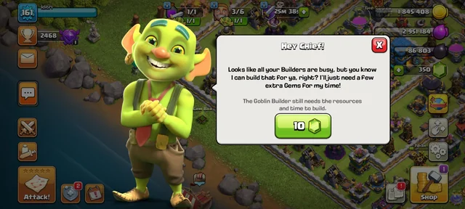
How are Premium Currencies made Desirable?
Exploit player impatience
Immediate Resources
Exploit player impatience
Speed up Construction

Slide 16
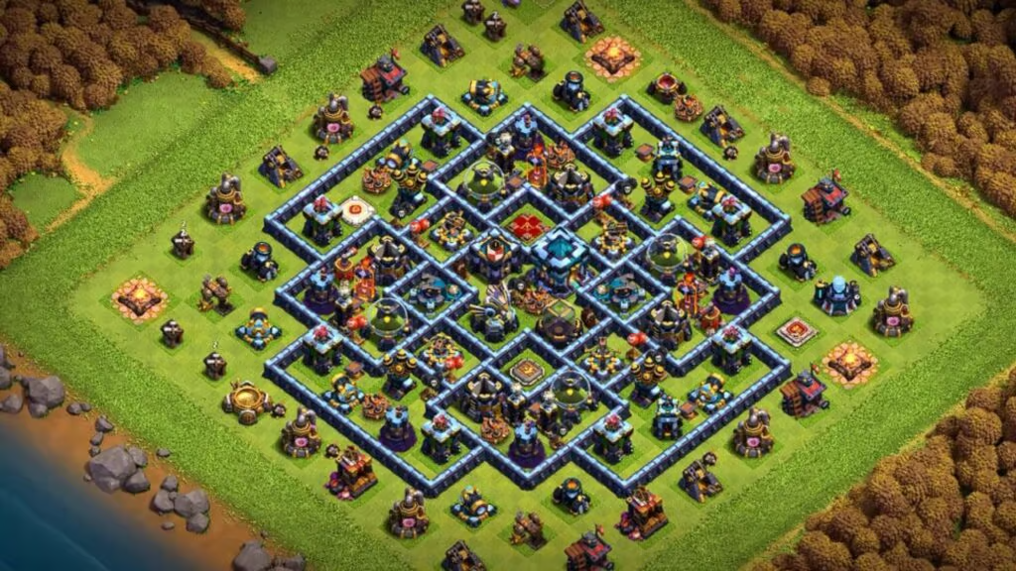
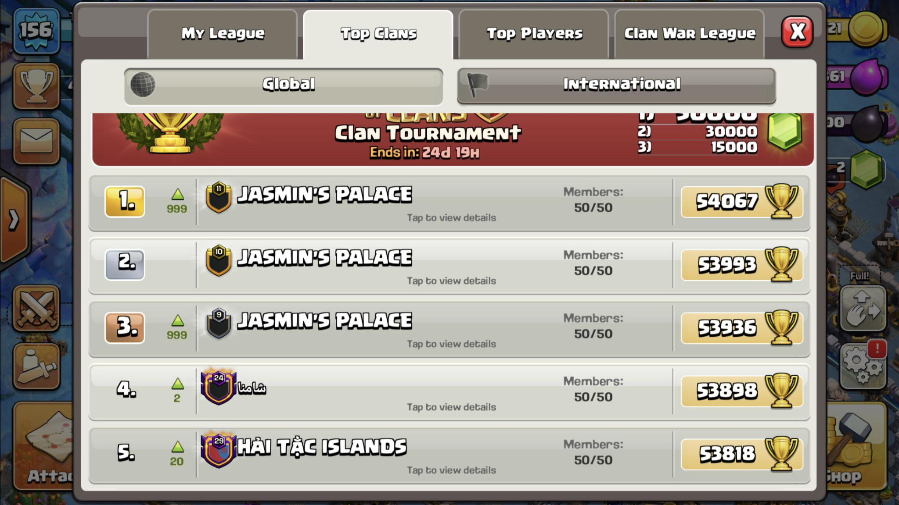
How are Premium Currencies made Desirable?
Sociability
Competition
Other Clans
Other Players
Comparison
Other Clans
Other Players
Friends

Slide 17
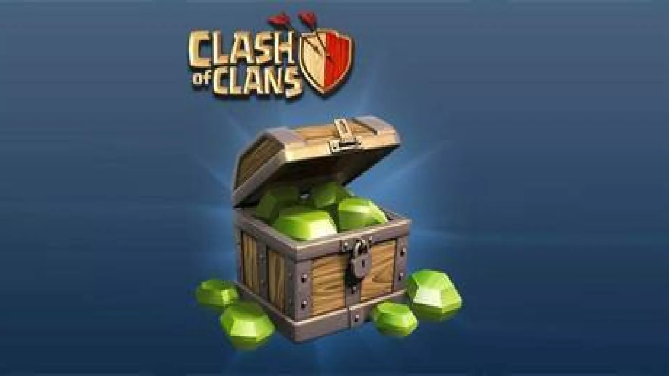
How gems affect player decisions?

Slide 18
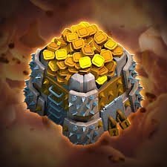
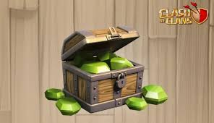
How gems affect player decisions?
Scarcity and Hoarding
Gems
Players save up
Try not to spend
Never use all of them
Gold & Elixir
Can regain completely in a few hours or days
Use freely
Okay to spend it all

Slide 19
How gems affect player decisions?
Scarcity and Hoarding
Gems
Players save up
Try not to spend
Never use all of them
Gold & Elixir
Can regain completely in a few hours or days
Use freely
Okay to spend it all

Slide 20
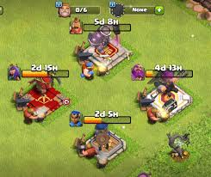
How gems affect player decisions?
Waiting is Worse
Waiting is worse when you know you don’t have to do it.
You have to wait for buildings to build in strategy games. If you saw someone else doing it in a multiplayer game you would want to do it but if you never saw it you’d never care.
Line Skip Pass
Seeing other people skip the line at a themepark makes you want to do it.
Most people wouldn’t think of a fast lane but once they see others have it they want it.

Slide 21
Question!
An example of when a game exploited player impatience
Example of how a game made the premium currency desirable

Slide 22
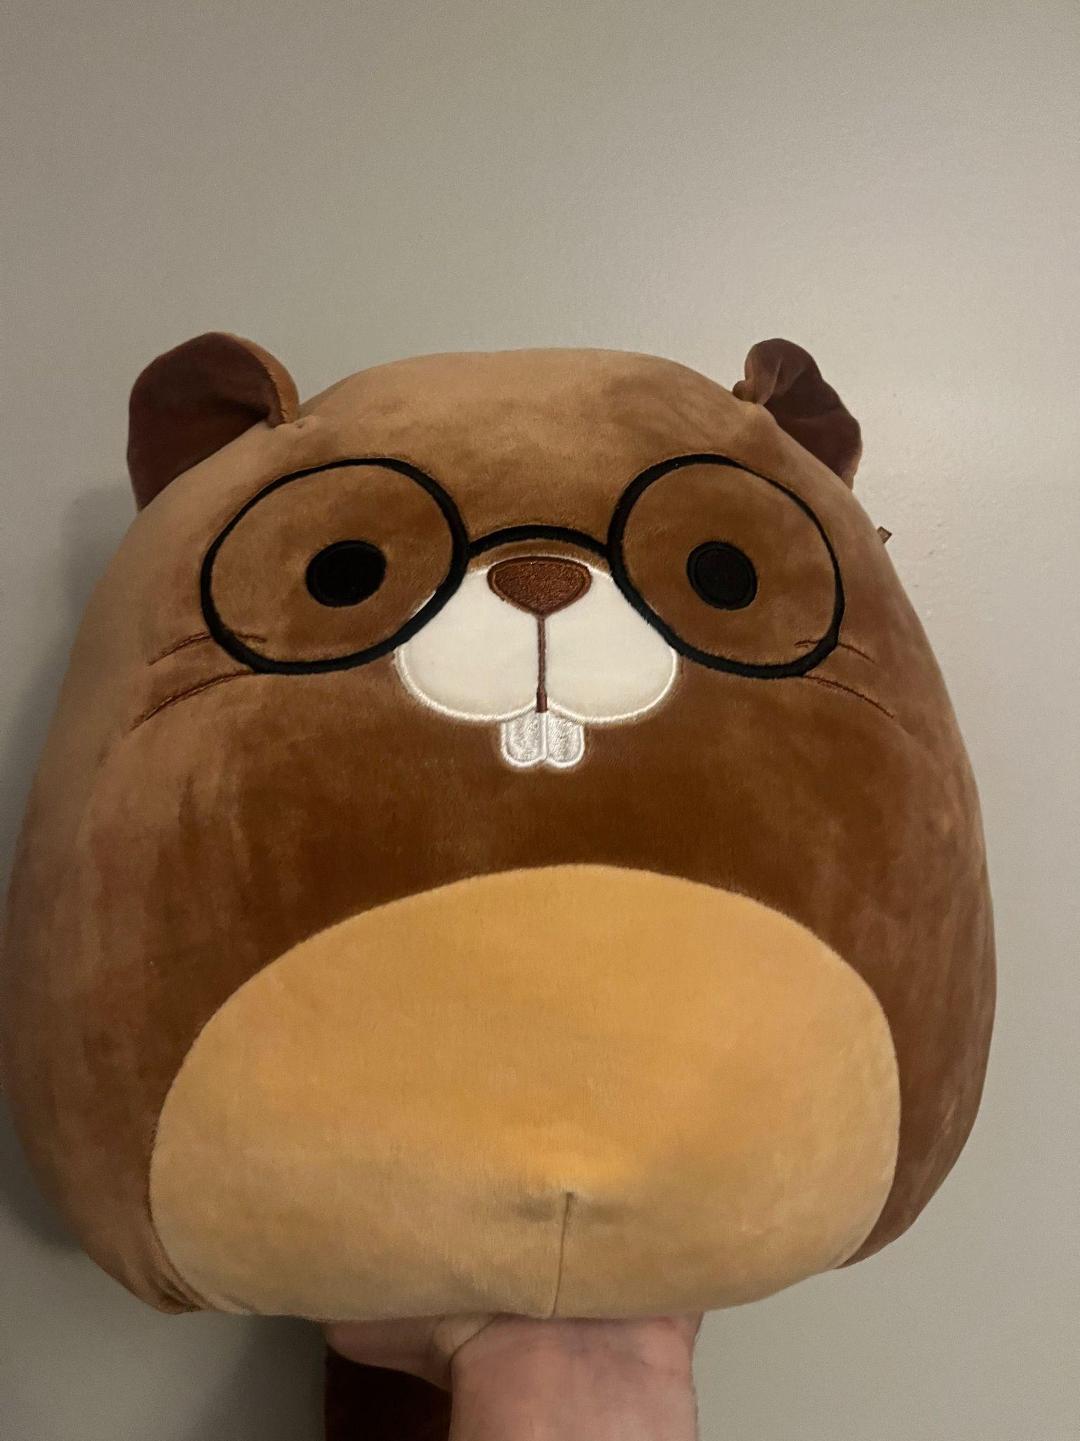
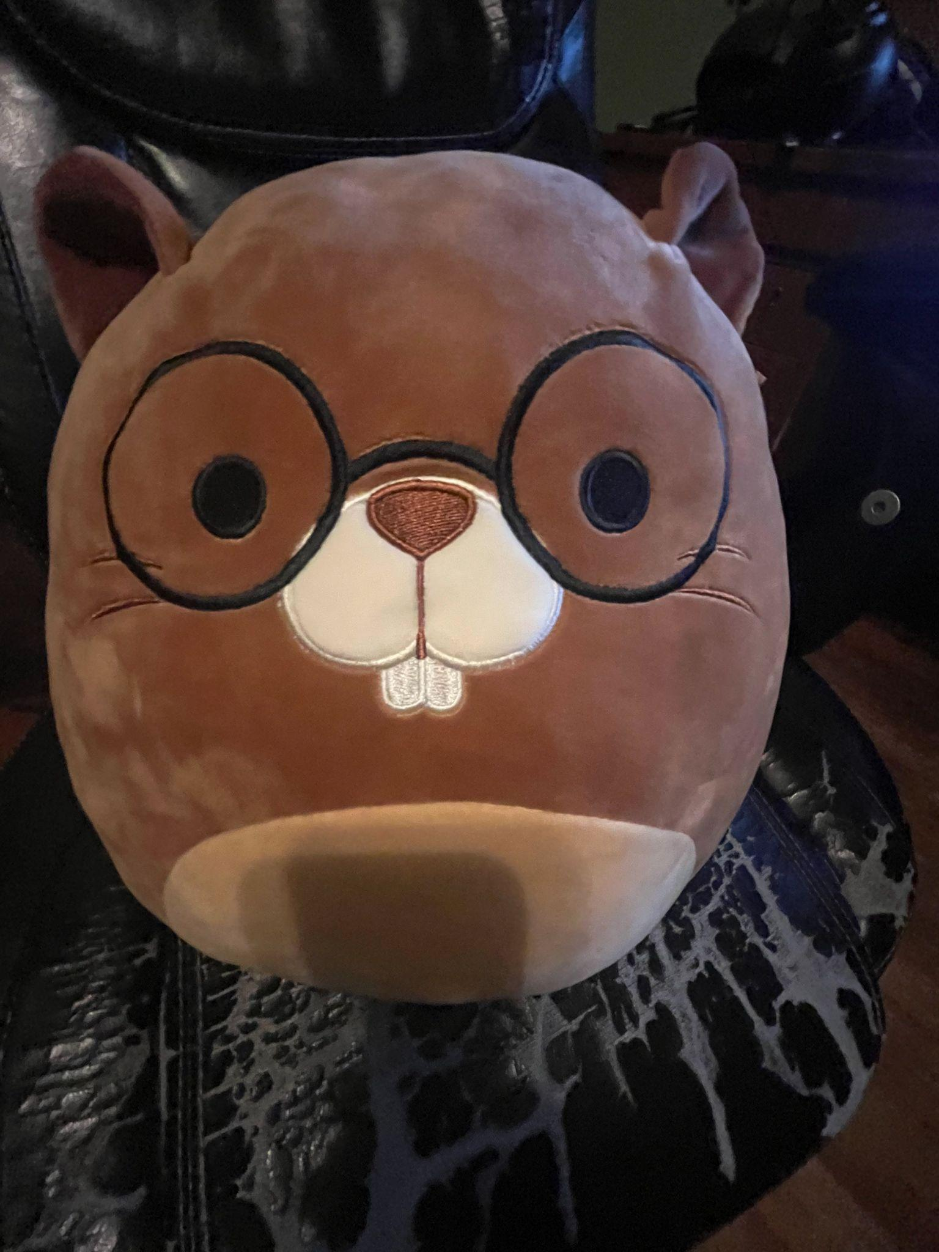
Discussion
How has the Pinch affected you in games?
The best Answer gets this stuffy

Slide 23
Thank you for Listening and Engaging! :)

Slide 24
Sources
Evans, E. (2016). The economics of free: Freemium games, branding and the impatience economy. Convergence, 22(6), 563-580.
Musabirov, I., Bulygin, D., Okopny, P., & Sirotkin, A. (2017). Deconstructing cosmetic virtual goods experiences in Dota 2. Proceedings of the 2017 CHI Conference on Human Factors in Computing Systems, 2054-2058.

